Slide 1
Microsoft Build

Slide 2
Building AI applications that leverage your data in Object Storage
Saurabh Sensharma, Principal PM, Azure Storage
Vishnu Charan TJ, Senior PM, Azure Storage
Vamshi Kommineni, Group Product Manager, Azure Storage

Slide 3
Agenda
AI Workloads and Storage requirements
Training & Fine Tuning
Retrieval Augmented Generation (RAG)

Slide 4
Bringing domain knowledge to LLMs
Prompt engineering
Fine-tuning
Retrieval augmentation (RAG)
In-context learning
Learn new skills
Learn new facts

Slide 5
AI Pipeline – Storage centric view
Ingestion
Training Data Preparation
Training
Inferencing
Data Collection & Ingestion
Data Cleaning
Data Preparation
Training & Checkpointing
Model Deployment & Inference
Raw Data
Cleansed Data
Training Data
Checkpoint Data
Base Model Weights
Unstructured Data Storage

Slide 6
AI Fine-Tuning – Storage centric view
Ingestion
Training Data Preparation
Fine-Tuning
Inferencing
Domain Data Collection & Ingestion
Data Cleaning
Data Preparation
Fine-Tuning & Checkpointing
Model Deployment & Inference
Raw Data
Cleansed Data
Training Data
+
Base Model Weights
Checkpoint Data
Fine Tuned Model Weights
Unstructured Data Storage

Slide 7
AI Pipeline - Storage Requirements
Ingestion
Data Preparation
Training / Fine-Tuning
Inferencing
Raw Data
Cleansed Data
Training Data
+
Base Model Weights
Checkpoint Data
Fine Tuned Model Weights
Unstructured Data Storage
Requirements
Training / Fine-Tuning
Deployment/Inference
Ingestion: Bring raw training data to Azure
Data Preparation: Integration with Spark, MosaicML, etc.
Training/Fine-Tuning: Data to GPU nodes, checkpoints to storage. Integration with PyTorch and other ML frameworks
Data Management: Secure & cost-efficient retention
Deployment: Model distribution and load times
Data Management: Model versioning, retention of inference inputs and outputs

Slide 8




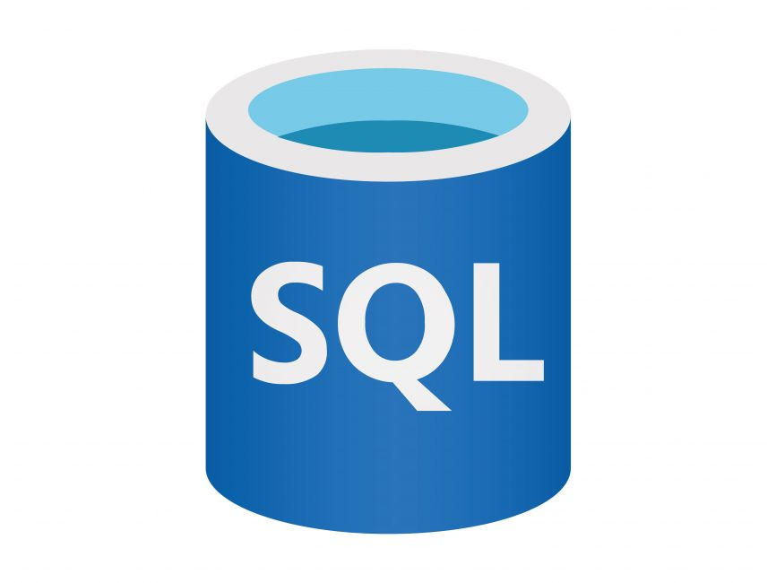


Options for AI Data on Azure
Preparation
Training
Inferencing
CosmosDB
OneLake + Fabric
Managed Lustre
Azure SQL
Blob/Data Lake Storage + Databricks
Blob Storage
Blob Storage

Slide 9


Azure Managed Lustre
Scalable, powerful, cost-effective, high-performance storage for the most demanding workloads in engineering, climate, energy, scientific research, and more
Accelerate HPC & AI workloads
Protect Application Investments
Azure Blob Integration
Fully Managed
Azure Kubernetes Services Integration

Slide 10
Azure Blob Storage: Multi-protocol, single storage platform
Blob API
ADLS API
NFS 3.0
SFTP
Object data
Analytics data
File data
File data
Server Backups, Archive Storage, Semi-structured Data
Hadoop File System, File and Folder Hierarchy, Granular ACLS, Atomic File Transactions
HPC Data, Applications using NFSv3 against large sequential read and write data sets
Applications/workflows requiring SFTP support
Hierarchical Namespace (HNS)
Common Blob Storage Foundation (FNS)
Object Tiering and Lifecycle Policy Management
AAD Integration, RBAC, Storage Account Security
HA/DR support through ZRS and RA-GRS

Slide 11
Training & Fine-tuning with Azure Blob Storage

Slide 12

Training and Fine-Tuning with Blob Storage
Scalable
Cost Effective
Multi-Protocol
Optimized for node-local access
Data Management
PBs of data, Tbps of R/W throughput
Tiered storage for long-term retention
Integrates well with analytics engines
BlobFuse2 with caching
Blob index tags, automated lifecycle management

Slide 13




Blobfuse2
GA + update
Virtual File System Driver to mount blob storage in your computing environment
Mount Blobs directly on VM/PC via Blobfuse
https://aka.ms/blobfuse
High Throughput access to Blob Storage
Virtual Machine/PC
Blobfuse mount
REST APIs
Easy to install and work with PiB scale data
Azure Blob Storage
Azure Kubernetes Services
Blob
Container
Blob
Container
Open-sourced & supported by Microsoft
Pod
Persistent Volume claim
Persistent Volume
Secure access to data
Blobfuse mount
REST APIs
Mount Blobs via Blob CSI driver in AKS

Slide 14
Demo: Blobfuse2 for AI training and fine-tuning
Vishnu Charan TJ

Slide 15





Blobfuse2: Caching options
File caching
Streaming with Block-cache
New
Downloads the files completely in chosen caching folder before serving to applications
Can only read files that can fit into chosen cache space
Configurable timeouts for predictable eviction policy
Useful for repeated reads that do not require frequent updates from Storage account: AI Training datasets
Serves the file for reads while downloading
Can read files larger than local disk/RAM space
Configurable pre-fetch, parallelism and block sizes
Uses the Buffer cache to deliver accelerated access
Useful for large file reads and writes
Checkpointing for AI training/fine tuning
HPC: ADAS Simulations, Genomic Sequencing
Computing Environment
Computing Environment
Applications
Applications
RAM
Azure Blob Storage
RAM
Azure Blob Storage
Buffer Cache
Buffer Cache
Blob
Container
Blob
Container
Blob
Container
Blob
Container
/mnt/cachespace
/mnt/blobfusemount
/mnt/blobfusemount
SSD or NVMe
SSD or NVMe

Slide 16
IOR Benchmark test for HPC systems
Objective
Maximizing available storage bandwidth using Blobfuse2
D96ds and D96ads Spot VMs
350 AKS Pods
IOR Benchmark setup
16,800 cores
Blobfuse2 via AKS CSI driver
> 2 PiB working data
https://github.com/hpc/ior

Slide 17
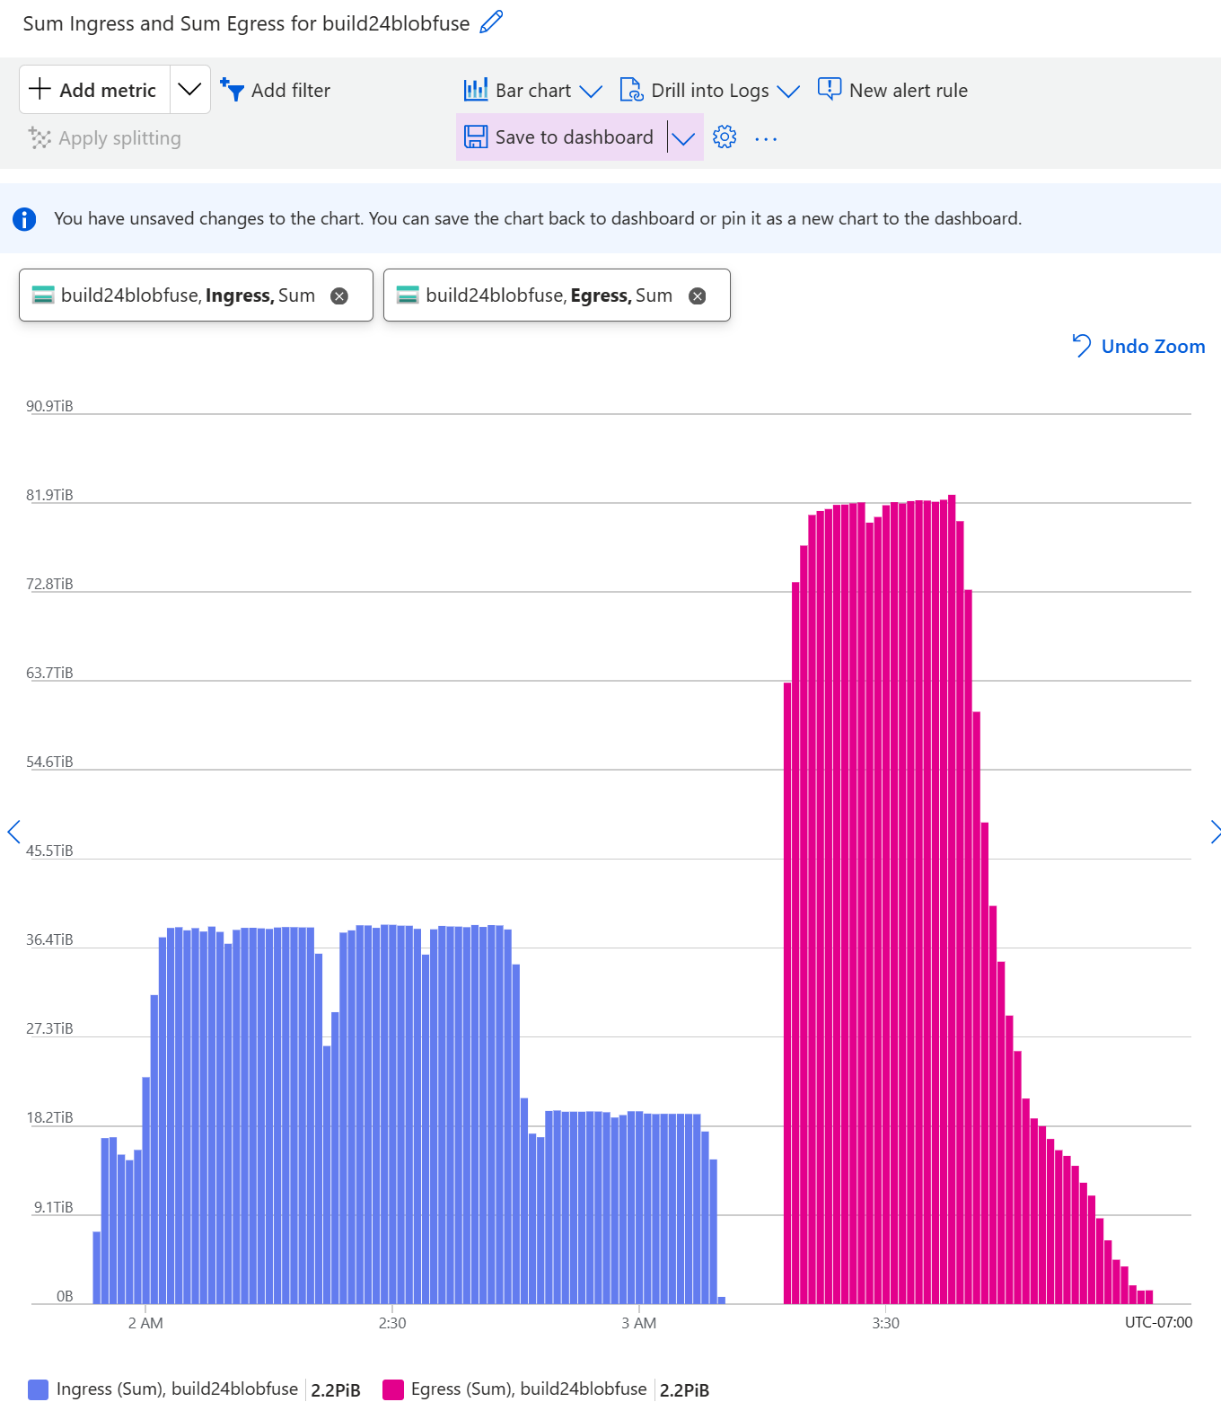
IOR Benchmark test for HPC systems
Peak Throughput during the Performance Run on a single Blob container
8.1 Tbps
Ingress
13.5 Tbps
Egress

Slide 18
Blob Storage: Scaled accounts
Increase Capacity, Bandwidth, IOPS to meet hyperscale customer asks
Scale across a much larger hardware footprint
Eliminate the need for sharding large workloads across accounts
No change to pricing, not a new product/SKU, goal is to auto-scale
Workloads
Storage
Scaled Account
Storage
Slice 1
Slice 2
Acct
Acct
Acct
Acct
Acct
Acct

Slide 19
RAG with Azure Blob Storage

Slide 20







RAG: Retrieval-Augmented Generation
Combine reasoning + knowledge
Key Elements
Retrieval System
Data Sources (files, objects, databases, etc.)
Externalized knowledge
Orchestrator drives interaction
Prompts = instructions + context + grounding data
Query → Knowledge
Achieving quality results
App UX
App Server, Orchestrator
Prompt + Knowledge → Response
Different workflows for different tasks
Evaluation & RAI
LLM

Slide 21
RAG Pipeline – Storage centric view
Vector DB Integration
Vector DB
Ingestion
Data Preparation
Retrieval
Response
Domain Data Collection & Ingestion
Data Cleaning
Data Chunking
Embedding Generation
Vector Similarity Search
Prompt Augmentation
Inference + Response
Raw Data
Cleansed Data
Cleansed Data Chunks
+
Metadata
Base/ Fine Tuned Model Weights
Secure Access
Unstructured Data Storage

Slide 22
RAG Pipeline – Storage Requirements
Ingestion
Data Preparation
Vector DB Integration
Retrieval
Response
Raw Data
Cleansed Data
Cleansed Data Chunks
+
Metadata
Base/ Fine Tuned Model Weights
Secure Access
Unstructured Data Storage
Requirements
Bring enterprise and domain-specific data to foundation models
Low latency access to models and data
Integration with Vector DB functionality
Timely data and index updates
Security and access control to core enterprise data

Slide 23
RAG with Blob Storage
Multi-Protocol
Low latency access
Vector DB Integration
Freshness
Security
Azure AI search, flexibility to BYO
Blob Change Feed
Change notifications
Azure Entra ID integration
RBAC and ABAC
Unified storage for heterogenous updates
Premium Blob Storage
Multiple indexes, dev-focused SDK/tools

Slide 24
Demo: Azure Blob Integration with Azure AI Services
Saurabh Sensharma

Slide 25





Demo: Azure Blob integration with Azure AI services
Integrated vectorization
Azure AI Search
Vector
Similarity Search
Azure OpenAI Studio
Ingestion
Data Preparation
Vector DB Integration
Retrieval
Response
PDF Files
Cleansed Data
Cleansed Data Chunks
+
Metadata
OpenAI GPT-x & Embedding models
Azure Blob Storage

Slide 26



Microsoft Fabric/OneLake and Azure AI integration
Data Pros
2
AI Developers
Data Scientists
Microsoft Fabric
3
Azure AI
1
1
OneLake

Slide 27
Demo: RAG with Azure Blob + LangChain + Pinecone
Saurabh Sensharma

Slide 28


Demo: RAG with Azure Blob, LangChain & Pinecone
Vector DB
Orchestrator
Orchestrator
Ingestion
Data Preparation
Vector DB Integration
Retrieval
Response
PDF Files
Cleansed Data
Cleansed Data Chunks
+
Metadata
OpenAI GPT-x & Embedding models
Azure Blob Storage

Slide 29
Premium Blob Storage for RAG
Latency (400KiB PDFs)
Operation | Premium Blob vs Standard (Hot) Blob
PutBlob (Data Ingest + Chunk Writes) | Premium ~2x faster
GetBlob (Vectorization) | Premium ~3x faster
GetBlob (Retrieval) | Premium ~3x faster
Premium delivers ~3x faster RAG performance with 65% savings on Transactions!

Slide 30
Key Takeaways
Leveraging Azure Blob for building AI Apps …
Ideal for AI Training and Fine Tuning
Accelerates building RAG based LLM Apps
Scalable
Cost-effective
Integrated
Interoperable
with storage tiers and automated lifecycle management
with Azure AI services
with vector DBs and orchestrators with SDK/tools
to Exabytes of data and many Tbps of throughput
Secure
with Entra ID integration, RBAC and ABAC
Integrated
Interoperable
with analytics engines for data preparation
BlobFuse2 for seamless use in GPU clusters
Low-Latency Access
Freshness
with Premium Blob Storage
with Blob change feed and change notifications

Slide 31

Thank You!
More information:
https://aka.ms/AzureStorageBlog
https://aka.ms/AzStorageFeedback
Your feedback is important! Visit to complete your session evaluations: https://aka.ms/MicrosoftBuildEvals
We’d love to learn about your AI scenarios:
https://aka.ms/AzureStorageAndAISurvey
If you have any questions, contact the team at AzureStorageFeedback@microsoft.com

Slide 32
Related sessions
 | Session code | Title | Date/Time | On Demand (Y/N)
Breakout | BRK100 | Advanced RAG with Azure AI Search – top questions answered | 05/23 12:30 PM | Y
Breakout | BRK108 | RAG at scale – build a multi-billion vector index with Azure AI Search | 05/22 10:15 AM | Y
Demo | DEM715 | Getting more out of your containerized workloads for less | 05/22 04:30 PM | N

Slide 33

Get expert help to simplify and accelerate your digital transformation
Scan to learn about Azure Migrate and Modernize & Azure Innovate
Aka.ms/AzureHeroOfferings

Slide 34
Copyright Microsoft Corporation. All rights reserved.

